Slide 1
Rethinking deepfake detection
Gabriel Simiyu and Jazper Toralba
Notes:
[Introduction] Today we're presenting our work on rethinking how we detect deepfakes.

Slide 2
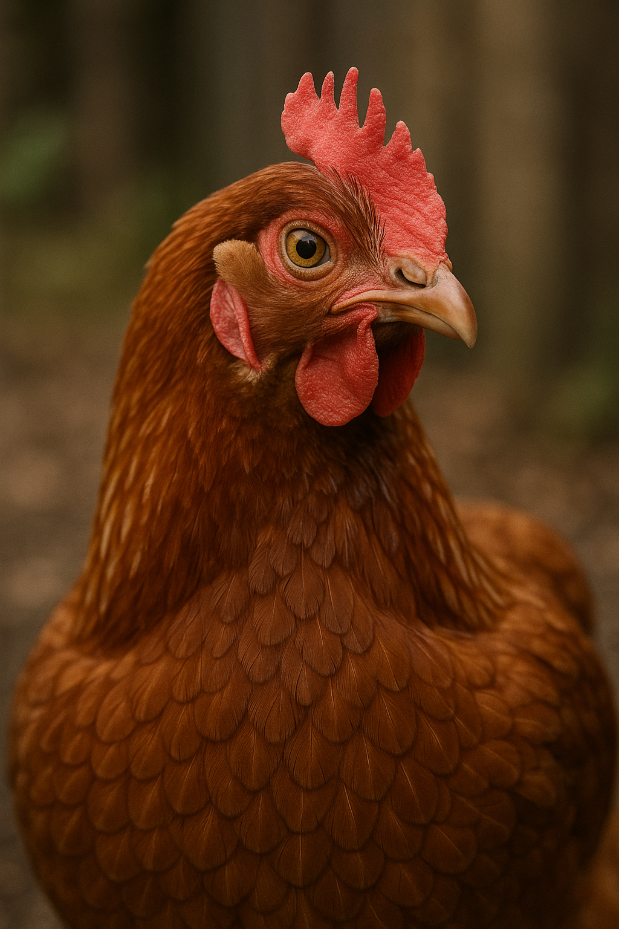
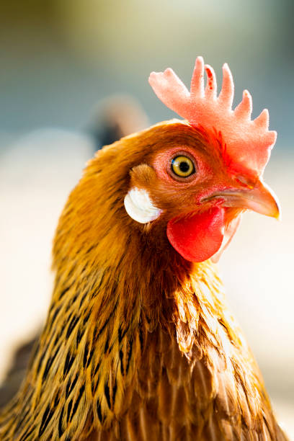
We Can No Longer trust what we see
Images from GANs and Diffusion models are now virtually Indistinguishable from authentic images
Misuse threatens political and economic domains
Notes:
Images from GANs and Diffusion models are now virtually indistinguishable from authentic images. This is both an incredible technological achievement and a serious problem
Think about this: In the past year alone, we've seen deepfakes used in political scams—creating false statements attributed to world leaders. We've seen financial fraud—CEO voice impersonation scams costing companies millions. We've seen identity theft and harassment campaigns using manipulated video and images.
And here's the troubling part: our detection systems are failing catastrophically on unseen models. This threatens trust in media, politics, economics. That's why we're here to propose our idea.

Slide 3
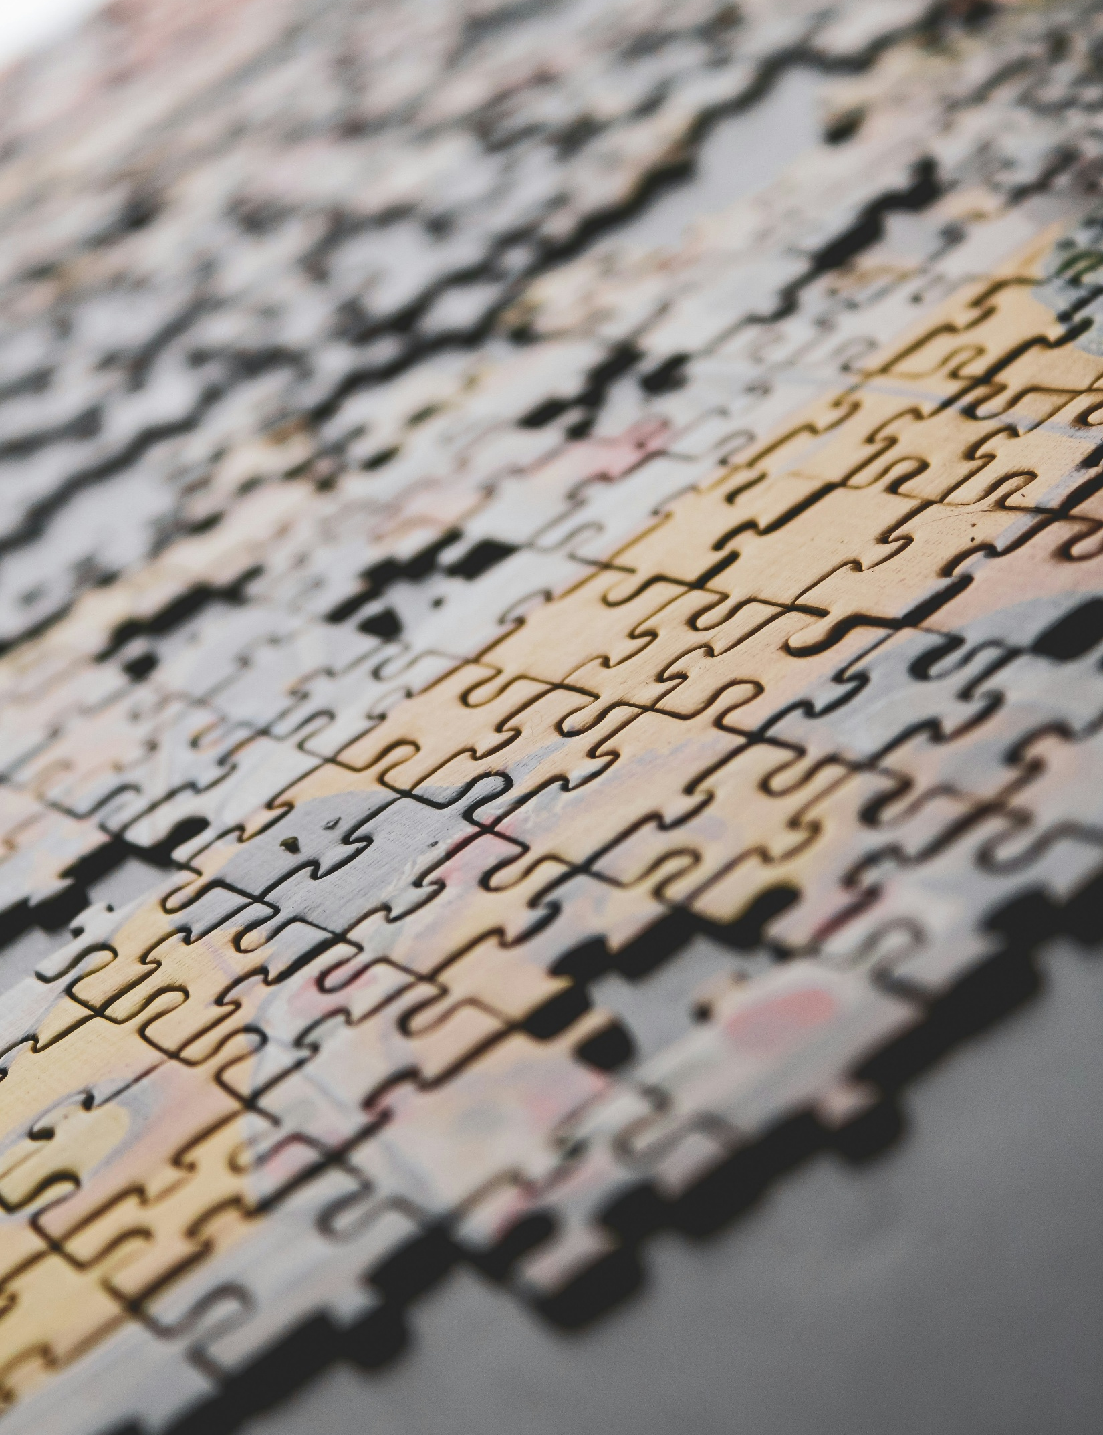
The Deepfake problem
Current detectors work well on training data, but fail catastrophically on unseen generators
The real world has a plethora of generation models; we must be able to generalize to keep up
Notes:
Here's the core issue: current deepfake detectors exhibit a fundamental flaw. They work exceptionally well on the specific generator they were trained on. But the moment they encounter a completely different model, their performance collapses.
This is the generalization problem. When a detector is trained on ProGAN-generated images, it learns very specific fingerprints of that generator—patterns unique to ProGAN's architecture and training procedure. But ProGAN isn't the only generator. We have StyleGAN, BigGAN, CycleGAN, Diffusion models, and emerging models like FLUX and Midjourney.
Each new model has different architectural characteristics, different training procedures, different fingerprints. So a detector trained on one model completely fails on another. The detector is overfitting to the training distribution instead of learning generalizable features.

Slide 4
The Generalization crisis
Notes:
This is what we call 'The Generalization Crisis.' It's the central challenge in deepfake detection research right now.
The data is sobering. When you train a detector on ProGAN and test it on ProGAN, you get 95% accuracy. That's excellent. But train on ProGAN and test on StyleGAN? Accuracy drops to 63%. Test on a Diffusion model? You're down to 40%.
This isn't a minor performance degradation. This is a crisis. It means our best detection methods are fundamentally broken for the real world, where multiple generators exist simultaneously.
The deeper problem is that we're trapped in an arms race. Every time a new generator emerges, researchers have to retrain detectors on that generator. Generators evolve faster than we can train detectors.

Slide 5
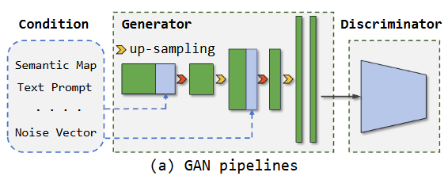
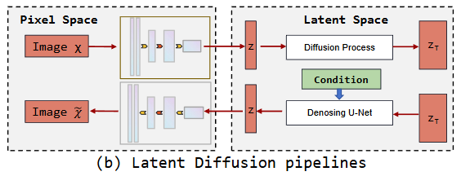
What everyone else is doing
Conventional Methods
Frequency based detection (Frank, Durall, F3-Net)
Analyzed global patterns across entire image
Looked at spectral distribution
Image-based detection (CNN Detection, Patchfor)
Trained on pixels directly
Found model specific “fingerprints)
“Frequency-based artifacts are insufficient for achieving generalization detection” – FreGAN findings
Notes:
Researchers have tried two main approaches to deepfake detection:
Frequency-based methods like Frank, Durall, and F3-Net take a different angle. They transform images into the frequency domain—looking at the Fourier transform—and analyze spectral distribution. The logic is: if you generate an image artificially, it will have different frequency patterns than natural photos.
The problem? Different generators have different frequency signatures. StyleGAN leaves different artifacts in frequency space than ProGAN. Diffusion models leave different patterns than both. So frequency-based methods don't generalize either.
Image-based methods like CNNDetection and Patchfor go the opposite direction. They train CNNs directly on pixel data and hope the network learns to detect what's fake. The assumption is: if we throw enough data and model capacity at it, the network will find generalizable patterns.
In practice, these methods learn model-specific fingerprints. They're overfitting just like frequency methods, just in a different way. The quote on the screen says it well: 'Frequency-based artifacts are insufficient for achieving generalization detection.'
So we have two approaches that both fail to generalize. We're stuck.

Slide 6
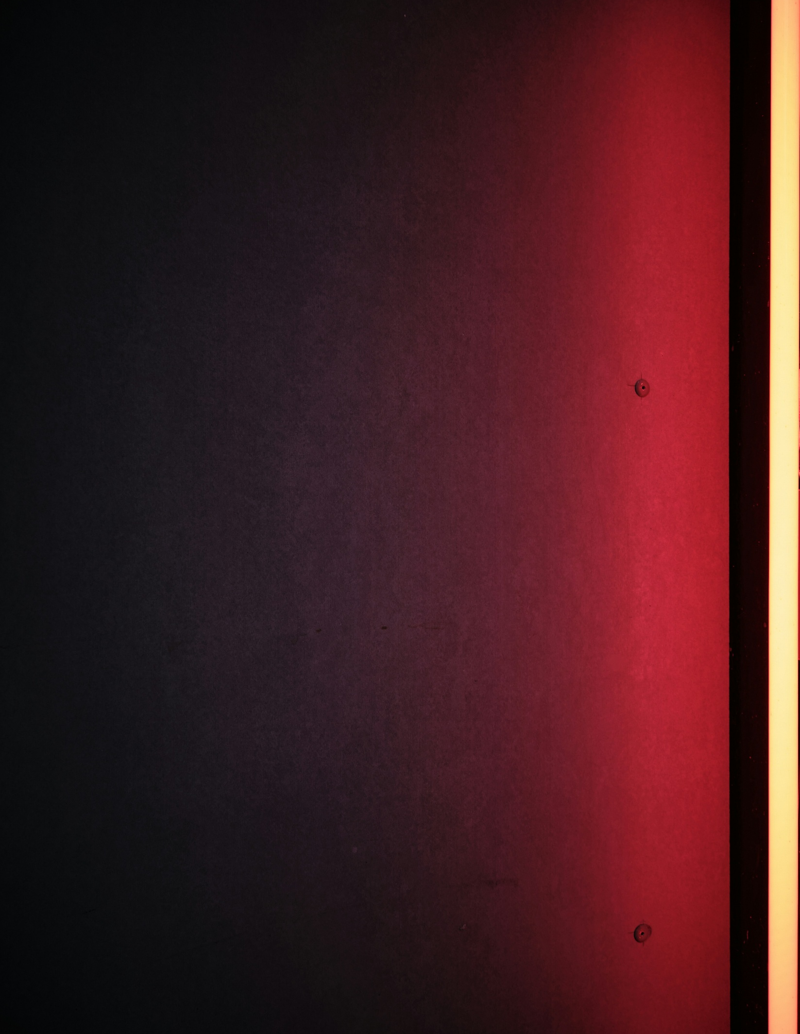
The deep-fake problem
Cross-Generator Performance Breakdown:
ProGAN -> ProGAN: 95% accuracy
ProGAN -> StyleGAN: 63% accuracy
ProGAN -> Diffusion: 40% accuracy
Root Cause: Overfitting to training distribution
Frequency methods fail due to diverse patterns
Spatial methods lack architectural understanding
We need universal detection even for Diffusion
Notes:
When we train on ProGAN and test on ProGAN, we get 95% accuracy. Excellent, right?
But test on StyleGAN: 63% accuracy. That's a 32-point drop. Test on Diffusion models: 40% accuracy. We're barely better than random guessing.
This data comes from existing benchmarks and published papers. It's not cherry-picked—it's representative of the state of deepfake detection.
The root causes are threefold:
First, overfitting to training distribution. The detector learns features specific to ProGAN's architecture and training procedure. When those features don't exist in StyleGAN or Diffusion, the detector is helpless.
Second, frequency methods fail due to diverse patterns. As I mentioned, different generators leave different spectral signatures. There's no universal frequency fingerprint.
Third, spatial methods lack architectural understanding. They try to learn patterns from pixels, but those patterns are generator-specific, not universal.
What we need is a method that captures something truly universal—something all generators share, regardless of their training procedure or architectural innovation.

Slide 7
The Key Observation
Up-sampling is generally used everywhere
All GANs use it (ProGAN, StyleGAN, BigGAN, etc.)
All Diffusion models use it via U-Net Decoder
Up-sampling transforms low resolution images to high resolution
This creates artifacts as LOCAL correlations between neighboring pixels
Nearest neighbor interpolation makes 2×2 pixels share the same value”
Notes:
So, the key observation: up-sampling is used everywhere. Absolutely everywhere.
When you build a GAN, you start with a latent vector—maybe 100 dimensions of random noise. You then use transpose convolutions or up-sampling operations to expand this to 256×256 or 512×512 resolution. This happens in ProGAN, StyleGAN, BigGAN, CycleGAN—every GAN ever built.
When you build a Diffusion model, you have a denoising U-Net. The decoder portion has up-sampling operations to expand from low resolution to high resolution. Every diffusion model does this.
FLUX, the new flow-matching model, uses up-sampling. Midjourney v6 is built on diffusion, and uses up-sampling. DALL-E, built on diffusion, and uses up-sampling.
Up-sampling is fundamental. It's not a choice. To transform latent codes into images, you must expand dimensionality. And when you do that through up-sampling, you create something: local correlations between neighboring pixels.
This is the key. Real photos don't have these correlations. Camera sensors capture light hitting the sensor at each pixel independently. But artificially generated images, created by up-sampling, and have predictable patterns in how neighboring pixels relate.

Slide 8
NPR METHOD: A Universal solution
Notes:
This is where the Neighboring Pixel Relationships method comes in. It's an elegant solution to the generalization problem.
Instead of learning model-specific fingerprints, NPR detects architectural artifacts. Specifically, it detects the artifacts left behind by up-sampling operations.
The insight is this: if all generators use up-sampling, then all fakes have up-sampling artifacts. These artifacts are fundamentally different from natural images. So if we can reliably detect up-sampling artifacts, we can detect fakes—regardless of which generator was used.
This is a paradigm shift from 'model-specific fingerprints' to 'architectural principles.' It's a shift from learning patterns specific to StyleGAN or ProGAN, to learning about something universal that all generators must do.

Slide 9
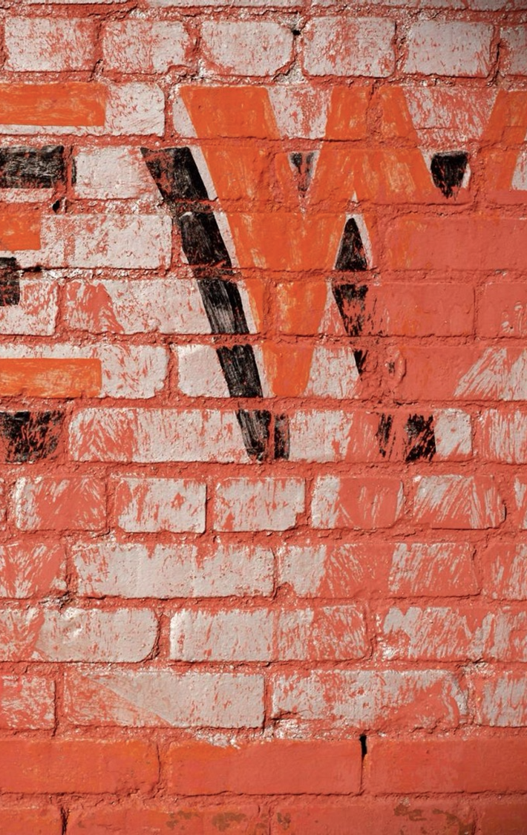
Neighboring pixel relationships
Mathematical Foundation:
Divides images into 2x2 grids and calculates differences between neighboring pixels
Each grid: V = [w1, w2, w3, w4]
NPR(V) = [0, w2-w1, w3-w1, w4-w1]
Why It Detects Fakes:
Real photo pixels are independent
Up sampling creates dependencies in generated images
CNN translation invariance preserves artifacts
Notes:
Here's how NPR works mathematically. It's actually quite simple.
Take any image and divide it into 2×2 pixel grids. So you have four neighboring pixels: call them w1, w2, w3, and w4.
NPR calculates: the difference between w2 and w1, w3 and w1, w4 and w1. You use one pixel as a reference and calculate how different the others are.
The formula is: NPR(V) = [0, w2-w1, w3-w1, w4-w1]
Why subtract instead of using absolute values? Because we want relative differences. This makes the method robust to content—if all four pixels are bright or all are dark, the differences are the same. The method detects structure, not brightness.
Now, why does this detect up-sampling?
When you up-sample, say using 2× nearest-neighbor interpolation, you take a 4×4 pixel image and expand it to 8×8, where each original pixel becomes a 2×2 block. The result? Your newly generated pixels have strong correlations with their neighbors.
In contrast, real photos have independent pixel values. Natural photos have large NPR differences—variation at every scale.
In fakes, you get small NPR differences—up-sampling creates dependencies.
So real fakes show up as small NPR values. Real photos show up as large NPR values. It's a signal that separates fakes from authentic images.

Slide 10
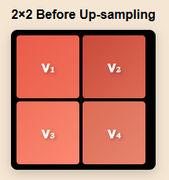
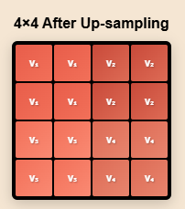
Up-sampling operation
2 x Nearest Neighbor Up-sampling
Why this matters for NPR
NPR Formula: V_c = {w_1 – w_j, w2 –w_j, w_3 – w_j, w_4 – w_j}
For perfect up sampling all differences would be 0
After CNN processing small but detectable correlation remains
Real Images: Large NPR differences (i.e. natural variation)
Fake Images: Small NPR differences (i.e. up-sampling residue)
Notes:
Let me show you visually what's happening.
On the left, you have a small 4×4 pixel image from a latent code. Each pixel has a value (represented by color or grayscale here).
On the right, you see 2× nearest-neighbor up-sampling. Each original pixel becomes a 2×2 block. So pixel 1 becomes a 2×2 block of pixel 1. Pixel 2 becomes a 2×2 block of pixel 2.
Notice what happens: within each original block, all four pixels are identical. This creates perfect correlations within the 2×2 grids.
If we apply NPR to this up-sampled image, we'd get zero NPR values within these blocks—the differences would be zero because all pixels are the same.
But real photos don't have this structure. In real photos, every pixel is slightly different due to natural variation, camera sensor noise, and lighting changes. NPR values would be large.
So this simple operation—comparing neighboring pixels—immediately reveals whether up-sampling happened.
Of course, real generators don't stop here. They add layers of convolutions, detail, and texture. But here's the key insight: those convolutional layers can't completely erase the up-sampling dependencies. They can modify them, but they can't destroy them entirely.

Slide 11
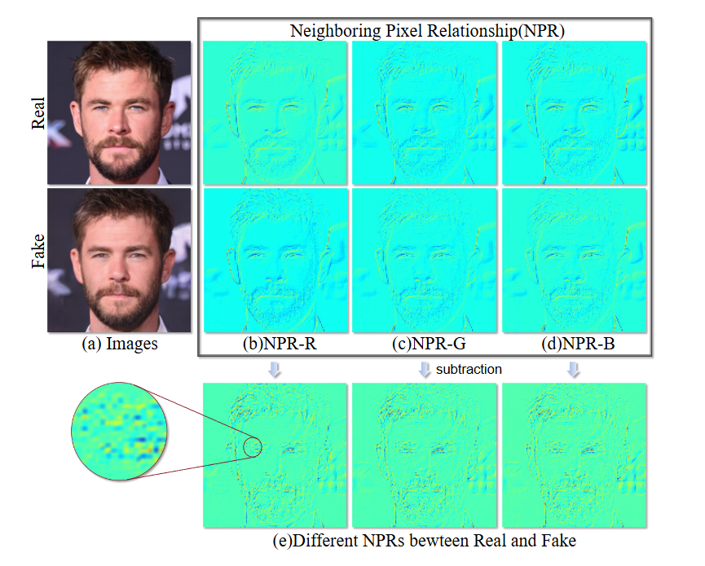
Why this works
Three properties make NPR powerful
Translation invariance: CNNs preserve the up-sampling trace
Local correlations: correlation remains even after generators add detail
Relative Measurements: resilient to different image content
Experiment Design
Training: Only ProGAN images
(4 classes: car, cat, chair, horse)
Testing: 28 different Models
17 GANs (including StyleGAN, BigGAN, CycleGAN, etc.)
11 Diffusion models (DDPM, Stable Diffusion, DALL-E, Midjourney, etc.)
Notes:
Why is NPR so robust? Three key reasons:
Translation Invariance. CNNs are translation invariant by design. They preserve local structure through pooling and convolution. This means the up-sampling trace—the local correlations we're detecting—survives through the generator's CNN processing. Even as the generator adds detail and refines the image, it can't completely erase the up-sampling pattern because the pattern is local and the CNN preserves local structure.
Local Correlations. The up-sampling artifacts are local—they're about neighboring pixel relationships, not global image structure. This matters because it makes them hard to erase. A generator could theoretically add noise or perturbation to destroy global frequency patterns. But destroying all local correlations would require modifying almost every pixel, which would severely degrade image quality. So generators don't do that.
Relative Measurements. NPR uses differences between pixels, not absolute values. This makes the method robust to content. If you train on car images and test on cat images, the absolute pixel values might be very different (cars are usually metallic, cats are furry). But the relative relationships—how neighboring pixels differ—is governed by the up-sampling architecture, not the content. So NPR generalizes across content types.

Slide 12
Mean accuracy across 28 different generators using NPR with ProGAN training only
92.2%
Notes:
The result was a striking 92.2% mean accuracy across all 28 generators, using NPR trained only on ProGAN.
In context. The prior the best detector achieved 80.6% accuracy. NPR improved on that by 11.6 percentage points.
But more importantly, NPR achieved this across fundamentally different generators. Not by fine-tuning for each generator. Not by retraining. Just NPR, trained on ProGAN, tested on 27 completely different models.
This is the proof of concept. It shows that up-sampling artifacts are really universal. It shows that architectural principles generalize better than learned fingerprints."

Slide 13
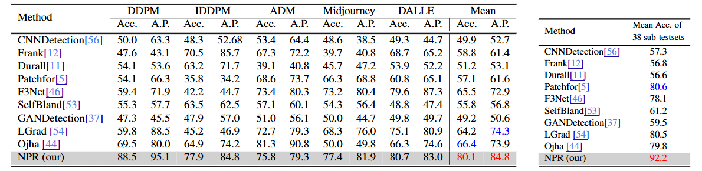

Slide 14
Results
GAN
Mean Accuracy: 92.5% on ForenSynths (8 GANs)
Mean Accuracy: 93.2% on Self-Synthesis (9 GANs)
Beats previous methods by 6.4%, even beating methods that were trained on the same test models
Diffusion
Mean Accuracy: 95.3% on Diffusion Forensics
Mean Accuracy: 95.2% on Ohja Diffusion Set
Mean Accuracy: 80.1% even on 1,000 step diffusions (DALLE, Midjourney)
Beats previous methods by 6.4%
Trained only on ProGAN and detected Diffusion models, even being out Ojha by 20.9%
Notes:
On GANs: The method achieved 92.5% mean accuracy on the ForenSynths dataset (8 GANs) and 93.2% on the Self-Synthesis dataset (9 GANs). These are strong results.
But here's the difference
On Diffusion models: 95.3% mean accuracy on Diffusion Forensics and 95.2% on the Ojha Diffusion set. The method actually performs better on Diffusion models than on GANs, despite never seeing Diffusion during training.
Even more remarkable that the there was a 80.1% accuracy even on high-quality 1,000-step diffusions from DALL-E and Midjourney. These are the best-quality fakes you can make—taking 1,000 denoising steps to produce nearly indistinguishable images. And NPR still catches them 80% of the time.
When compared against prior methods, NPR beats them by 20.9% on Diffusion model which is a massive gap.
This is not incremental improvement. This is a paradigm shift. The method discovered that architectural principles really do generalize universally.

Slide 15
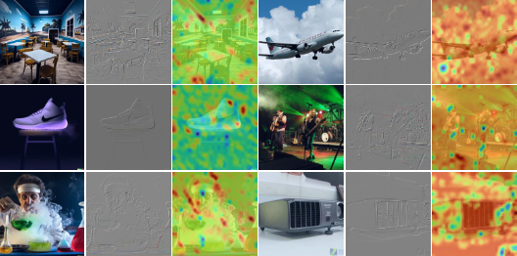
Class Activation Map (CAM) Visualization "The CAMs for real images highlight a broader portion of the image, whereas the CAMs for fake images tend to emphasize localized regions."
Notes:
A common criticism of any detection method is: what is it actually detecting? Is it finding real artifacts, or just learning patterns that correlate with fake/real split?
Class Activation Maps (CAMs) help answer this. They show which regions of the image the CNN is focusing on when making its decision.
Look at the real images: the CAM highlights are broadly distributed across the image. The network is attending to various regions with no particular pattern.
With the fake images: the CAM highlights are concentrated and localized. The network is focusing on specific regions where up-sampling artifacts are strongest.
This is evidence that NPR is detecting real architectural artifacts, not arbitrary patterns. The network is learning to focus on regions where up-sampling creates the strongest signal.
If NPR were just learning random patterns that correlated with fake/real, we'd expect different CAM patterns. Instead, we see localized focus on structural artifacts—which is exactly what we'd expect if the method is detecting up-sampling artifacts.

Slide 16
NPR Hyperparameters
Does it matter how the implement NPR?
Grid size(l): 2x2 works best since most generators us 2x up-sampling
Reference pixel (w_j): Any pixel generally works
Notes:
A natural question: how sensitive is NPR to design choices? What if we used 3×3 grids instead of 2×2? What if we chose a different reference pixel?
The paper tested this. It turns out NPR is remarkably robust to hyperparameter choices.
Grid size: 2×2 works best because most generators use 2× up-sampling. Using 3×3 grids or 4×4 grids reduces performance—you're not matching the up-sampling scale. Using 2×2 is optimal.
Any pixel in the grid works about equally well. The paper tested all four pixels as reference (subtract from w1, w2, w3, w4) and results were nearly identical. This robustness is important—it means the method isn't fragile.
Color channels: Treating RGB channels separately works best, which makes sense since up-sampling happens independently per channel.
This robustness is a strength. It means the method isn't tuned specifically to ProGAN or any single generator. It's not exploiting quirks of specific architectures. It's detecting something fundamental.

Slide 17
OUR HYPOTHESES
Hypothesis 1: Can NPR generalize to 2025’s newest models?
Test on FLUX, Midjourney v6, DALL-E 3
Expecting less than 80% accuracy despite architectural changes
Hypothesis 2: NPR has exploitable vulnerabilities
Gradient based adversarial perturbations
Expect less than 60% accuracy when tested
Hypothesis 3: Increase robustness with NPR and Frequency Features
Utilize spatial and frequency features
Expecting 5-10% improvement in robustness

Slide 18
Implementation Architecture
Code Repository Structure:
data/ (ForenSynths 4-class subset)
models/ (NPR, Frequency, Hybrid detectors)
experiments/ (H1, H2, H3 testing scripts)
preprocessing/ (NPR extraction pipeline)
Key Components:
NPR Feature Extractor (2×2 grid analysis)
CNN Classifier (1.44M parameters, matching original)
Adversarial Training Module (FGSM, PGD, C&W)
Evaluation Framework (metrics, ROC curves)
Notes:
We're planning to design a modular code so each component is testable independently. The NPR extractor is the heart—it divides images into 2×2 pixel blocks and calculates the differences. These go into a standard CNN classifier. For adversarial robustness, we would build in gradient-based attack generation. Everything would be configured via YAML files so we can easily swap datasets or hyperparameters between experiments.

Slide 19
Experiments:
Experiment 1: Cross-Architecture Generalization
Training: ProGAN (ForenSynths)
Testing: FLUX, Midjourney v6, DALL-E 3
Metric: Accuracy (%)
Success Threshold: ≥75% average
Experiment 2: Adversarial Robustness
Training: Adversarial training with PGD
Testing: FGSM, PGD, C&W attacks (ε=8/255)
Metric: Robust accuracy under attack
Success Threshold: ≥60% robust, >85% clean
Experiment 3: Hybrid Features
Training: Concatenated NPR + Frequency features
Testing: Same as Exp 1 + attacked images
Metric: Accuracy improvement over NPR alone
Success Threshold: ≥5-10% improvement
Notes:
Here's an overview of our three experiments. They're designed to run in parallel, so we can test all three hypotheses simultaneously on different GPUs . Experiment 1 answers: if NPR generalizes to 2025 models? Experiment 2 asks if attackers can fool NPR and Experiment 3 explores if we can make it better by combining approaches. Each uses the same base training data but tests different aspects of generalization. All three can run simultaneously because they use the same base training data but test different questions.

Slide 20
Training Data: ForenSynths ProGAN 4-Class
Dataset Composition:
Source: ForenSynths (publicly available)
Generator: ProGAN only
Categories: Car, Cat, Chair, Horse (4 classes)
Images per category:
Fake (ProGAN): 4,500 images
Real (LSUN): 4,500 images
Total per category: 9,000 images
Overall total: 36,000 images
Resolution: 256×256 pixels
Data Split:
Training: 70% (25,200 images)
Validation: 15% (5,400 images)
Test: 15% (5,400 images)
Why This Dataset? ✓ Matches original paper methodology (reproducibility) ✓ Public, non-proprietary ✓ Sufficient diversity for robust features ✓ Manageable size for single-GPU training ✓ Well-studied baseline (proven effective)
Notes:
We chose ForenSynths because the original paper already validated NPR on this dataset. This lets us confirm we can reproduce their 92.2% accuracy baseline before moving to new models. The 4-class split is intentional and it is enough diversity to learn robust features but small enough to train and iterate quickly.

Slide 21
Test Datasets for Hypothesis 1: 2025 Newest models
Category | Model 1: FLUX | Model 2: Midjourney v6 | Model 3: DALL-E
Release | 2024 (open-source) | 2024 update | 2023 → integrated updates 2024
Architecture | Flow-matching (not diffusion) | Proprietary, text-to-image | Proprietary API-based
Real Images | COCO/ImageNet equivalents | Public Discord communities (ethically sourced) | Matched set from curated sources
Why? | Different architectural paradigm—true architectural diversity test | Most popular commercial model, represents real-world threat | Leading model, integrated with ChatGPT ecosystem
Expected Performance:
Baseline (ProGAN, seen): ~95-99%
New models (unseen): 70-85% (expected)
Notes:
We're deliberately testing three different architectures. FLUX uses flow-matching, which is fundamentally different from diffusion models the original paper saw. Midjourney v6 is the commercial standard—if NPR can detect Midjourney, it's practical. DALL-E 3 is the most accessible via API. We're collecting 1,000-2,000 images per model to ensure statistical significance. Our success criterion is 75% average accuracy across all three.

Slide 22
NPR has exploitable vulnerabilities (Hypothesis 2):
Evaluation Protocol:
Generate attacks using clean training data
Test detector against attacked images
Measure accuracy drop from baseline
Train adversarial NPR using PGD perturbations
Re-test robust detector against all attacks
Success Criteria:
Robust accuracy (PGD attacked): ≥60%
Clean accuracy (unattacked): >85%
No catastrophic collapse to random guessing (<50%)
Attack Type | Description | Strength | Purpose
FGSM | Single-step gradient attack | ε = 8/255 | Test basic vulnerability
PGD | Multi-step iterative attack | α=2/255, steps=20, ε=8/255 | Test strong adversary
C&W | Optimization-based attack | confidence=0, 100 iter | Test adaptive attacker
JPEG Compression | Social media compression | 90-95% quality | Realistic degradation
Notes:
Adversarial attacks are crucial because any gradient-based detector can be attacked. Fast Gradient Sign Method is a simple single-step attack—if we fail there, we have basic vulnerabilities. PGD is the gold standard—it's iterative and strong. C&W is optimization-based, used by security researchers. We're also testing social media compression because real-world deepfakes get compressed. Our goal isn't perfect robustness—that's unrealistic—but demonstrating that adversarial training makes detection meaningful even under attack.

Slide 23
Hybrid Spatial-Frequency Features (Hypothesis 3):
NPR Features (Spatial Domain)
Extracts local pixel relationships
Input: 256×256 image
Output: 2×2 grid differences
Captures up-sampling artifacts
Frequency Features (Frequency Domain)
Fourier transform + magnitude spectrum
Input: 256×256 image
Output: Frequency bins
Captures global spectral patterns
+
Hybrid Feature Vector
Concatenate NPR + Frequency features
Train single CNN on combined representation
Learn joint spatial-frequency decision boundary
Expected Benefits:​
Complementary information: NPR catches local artifacts, Frequency catches global patterns​
Robustness: Attacking one modality doesn't neutralize the other​
Accuracy improvement: 5-10% expected on both clean and attacked images
=
Notes:
Different feature spaces provide independent information. NPR is great at local structure but vulnerable to gradient attacks targeting pixel space. Frequency features are good globally but vulnerable to spatially-localized adversarial attacks. By combining both, we create a harder target—an attacker would need to fool both domains simultaneously. We expect 5-10% improvement, which is meaningful in a detection system.

Slide 24
Comparison Table:
Approach | Clean Accuracy | Robust Accuracy | Computational Cost
NPR only | ~92% | ~55% | Baseline
Frequency only | ~85% | ~48% | Baseline
Hybrid NPR + Freq | ~97% | ~65% | +20%

Slide 25
Hardware Requirements & Time Estimates:
Phase | Duration | Notes
NPR feature extraction | 2-3 hours | One-time preprocessing
Frequency extraction | 1-2 hours | One-time preprocessing
NPR model training (200 epochs) | 8-12 hours | Standard training
Adversarial training (PGD) | 24-36 hours | ~3-5× slower
Hybrid model training | 10-15 hours | Slightly heavier features
Inference + evaluation | 4-6 hours | Testing on all models
Total per hypothesis | ~40-50 hours | Parallelizable
Total all three | ~100-150 hours | 2-3 weeks wall time
Hardware (TTU HPCC or equivalent):
GPU: NVIDIA RTX 3090 or RTX 4090 (24GB VRAM)
CPU: 8+ cores, ≥32GB RAM
Storage: 500GB SSD (dataset + checkpoints + logs)
Cost: Covered by TTU HPCC allocation (or ~$50/month cloud)
Optimizations: ✓ Mixed-precision training (40-50% speedup) ✓ Multi-GPU data parallelism (1.8-1.9× speedup for 2 GPUs) ✓ Pre-computed features (saves 3-5 hours per experiment) ✓ Early stopping (stops training when validation plateaus)
Timeline for Completion:
Sequential: 150 hours ÷ 8 hrs/day = 19 days
Parallel (2 GPUs): 150 hours ÷ 24 hrs/day = 6-7 days
Recommended: 2-3 weeks with aggressive parallelization
Notes:
We've carefully budgeted computational time. The bottleneck is adversarial training—it's slow because we're generating attacks every iteration. But it's parallelizable—we can run Experiments 1, 2, and 3 simultaneously on separate GPUs. TTU's HPCC has GPU nodes available, so we're not blocked. Even with one GPU, we have sufficient time to complete and iterate before the December 9th deadline

Slide 26
Deliverables December 9th
Trained Models (3 Variants)
NPR detector
Code Repository
GitHub-ready, well-documented
Results Dataset
Per-image predictions (all test sets)
Adversarially robust NPR detector
Hybrid spatial-frequency detector
Format: PyTorch .pth files + architecture definitions
Reproducible: Saved with training config and random seeds
Configurations files for each experiment (YAML)
README with setup instructions
Data loading and preprocessing pipeline
Fully reproducible: same results from same code + seeds
Per-model accuracy metrics and confusion matrices
ROC curves and AUC scores
Comparative performance tables
Notes:
We're committing to full reproducibility—any researcher should be able to download our code, use our config files, and reproduce our results exactly. The code will be modular so others can adapt it for their own datasets or models.

Slide 27
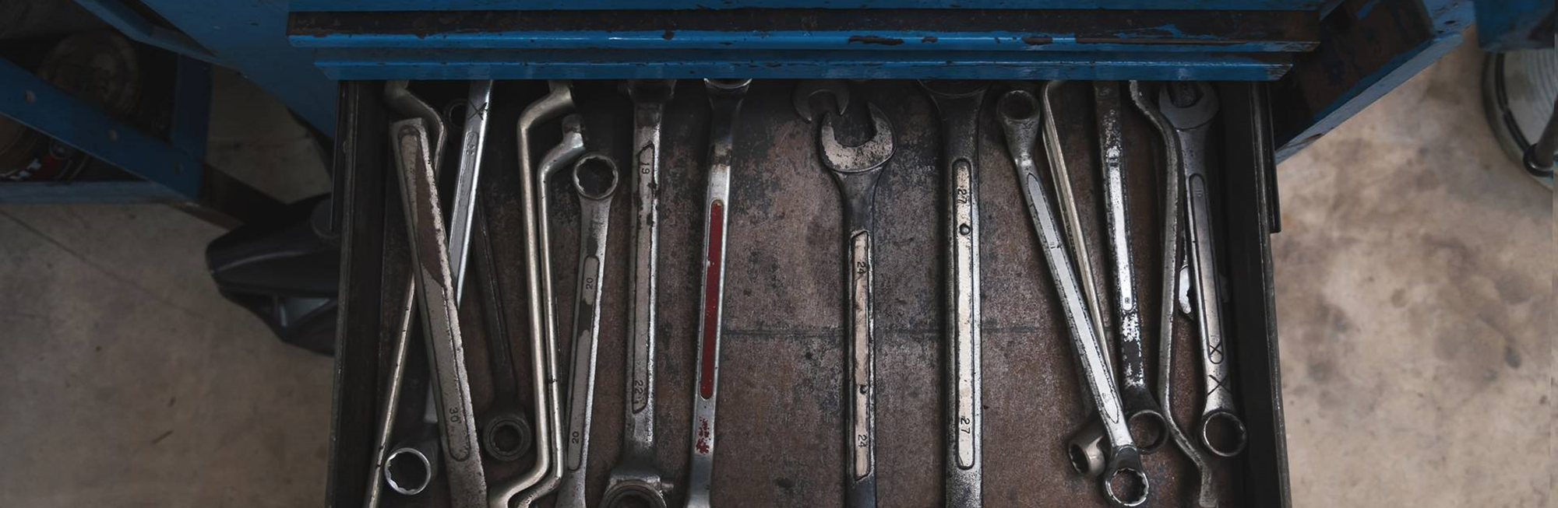
Q+A
We will now open the floor for questions.

